Slide 1

Library Management System
OBJECT ORIENTED SOFTWARE ENGENEERING PROJECT
Group 10
SY BBA-CA

Slide 2


Team Members
1. Ashwini Korde (43)
2. Srushti Kange (41)

Slide 3


Team Members
3. Monika Borse (14)
4. Aditya Kalkote (40)

Slide 4

Team Members
5. Hrushikesh Gutte (33)

Slide 5
What Is Library Management System?
A library management system is designed to manage all the functions of a library.
A library management system is used to maintain library records. It tracks the records of the number of books in the library.
The purpose of a library management system is to provide instant and accurate data regarding any type of book, thereby saving a lot of time and effort.

Slide 6


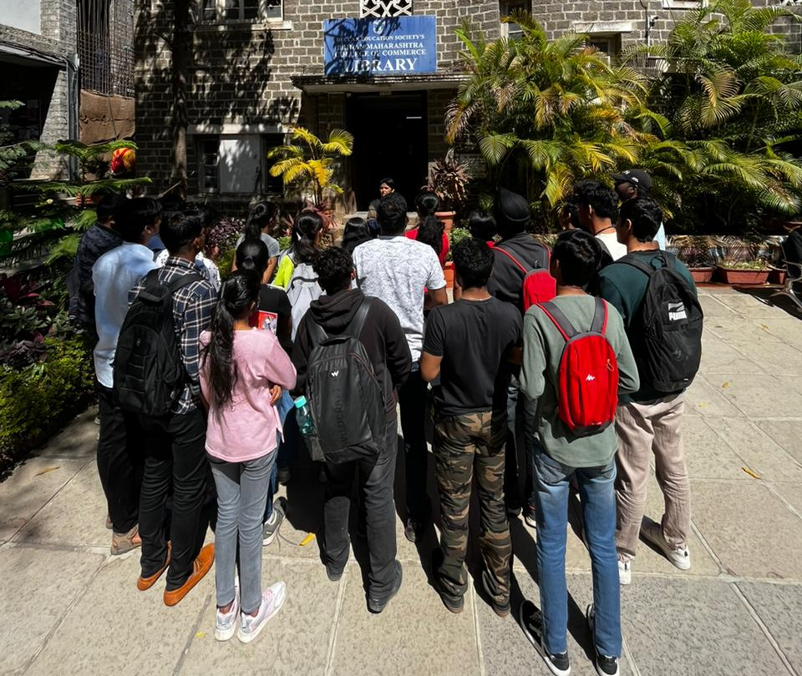

Library Visit
Under guidance of Prof. Kausar Biyabani

Slide 7
Specifications
1.Book issue details :-
The book is issued for – 7 days for Student and no specified return period for Faculties/Professors.
After 7 days student need to renew it (subject to availability & demand).
If the book is in demand further issue is not done to same student, if not then the book has to be surrendered for 2 days only then it can be re-issued.
Students can issue 2 Books at once and Faculties/Professors can issue 10 Books at a time.
Passed out students can issue books by verifying Gov ID/Aadhaar/Pan Card/Driving License within library premises only.
Books are issued by scanning the barcode on books & barcodes of student/faculty/professor ID cards.
Newspapers are also issued to students for a single day within library premises only.
Magazines can only be issued to Faculties/Professors for a period of 15 days. These magazines are marked with a yellow card.
Carrying Forward above specifications, late return has fine applicable to students ₹2/day (system inactive as of now).
If the issued book is lost/damaged, student is expected to return the exact book with exact edition, in case same edition is unavailable, student must submit latest edition, in case no edition is available in market no fine is collected from student, but student must find the book and return it to library.
Students can recommend book provided recommendation slip signed by a:subject expert b: HOD(Head of Department).

Slide 8
Book Details:
Purchase of books is an either grant or non-grant. When it is grant, money is granted by U.G.C (University Grant Commission). When non-grant, College/Society has to pay it from their budget.
There are over 1,00,000 books available in our library, with a total of 97,878 books having accession numbers.
Each book processes three numbers: 1. Accession Code 2. Serial Number 3. Barcode.
Accession numbers are generated manually offline and are updated to correspond with the name and numbering series of each book.
Books are never issued without proper identification in the form of an ID card and signature.
Obsoleted(Outdated) books are either donated or recycled into paper pulp. To ensure efficient inventory management, a new barcode is generated for each new book that enters the library.
Once in 5 years, stock verification is done by library department physically.

Slide 9
Shelving Details:
Every Book has accession number & Shelf ID.
Shelving is done with the help of library staff members, books are checked, rearranged on regular basis.

Slide 10
Digital Library
The library maintains an online and offline system.
Digital Library Platforms –
Pearson.com, McGraw Hill, Sage Publication, Wiley Publishers, Inflibet, CMIE, RBI Bulletin.
C. College pays the subscription for accessing the books on these digital library platform which is for 3-5 years.
D. Books on the digital library are for read only purpose and cannot be downloaded.
E. Once the book is accessed, you get an email regarding that book.
F. Digital Library is available in smartphones too named as ‘M-OPAC’(Mobile-Online Public Access Catalogue).

Slide 11
Context Level Diagram

Slide 12
Context Level Diagram
A context level diagram is a macro or a bird’s eyeview of the entire system.
A context level diagram shows where the system begins, what are the various dataflows and where does system end.
Context level diagram defines the scope of the system, it is also called as 0th zeroth level diagram.

Slide 13
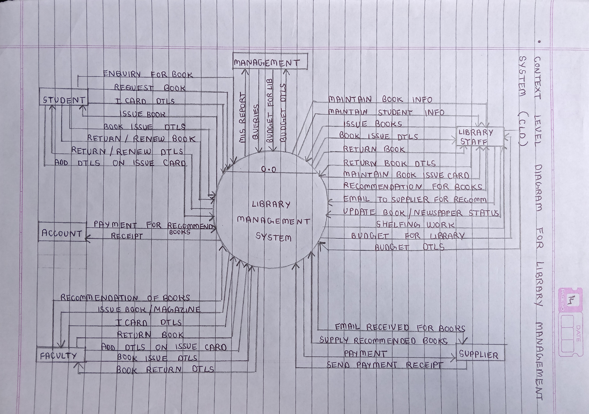
Context Level Diagram

Slide 14
Data Flow Diagram

Slide 15
Data Flow Diagram
A data flow diagram is a representation of data flow through a system during which it is processed as well.
The flow of data from external source or internal source to its destination is shown by a diagram.
Data flow diagrams define the functionality of a system whereas flow diagram shows how to make a system function.

Slide 16
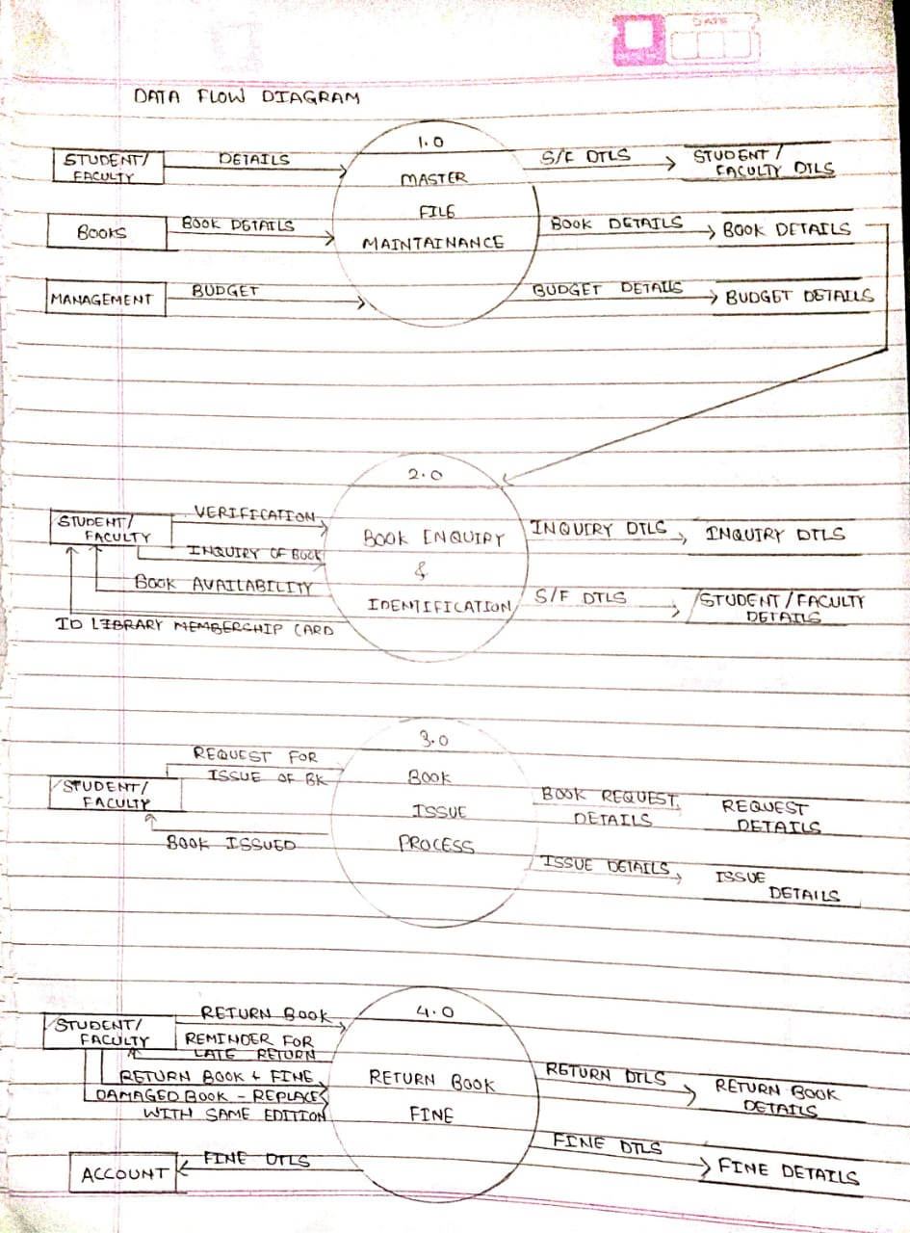
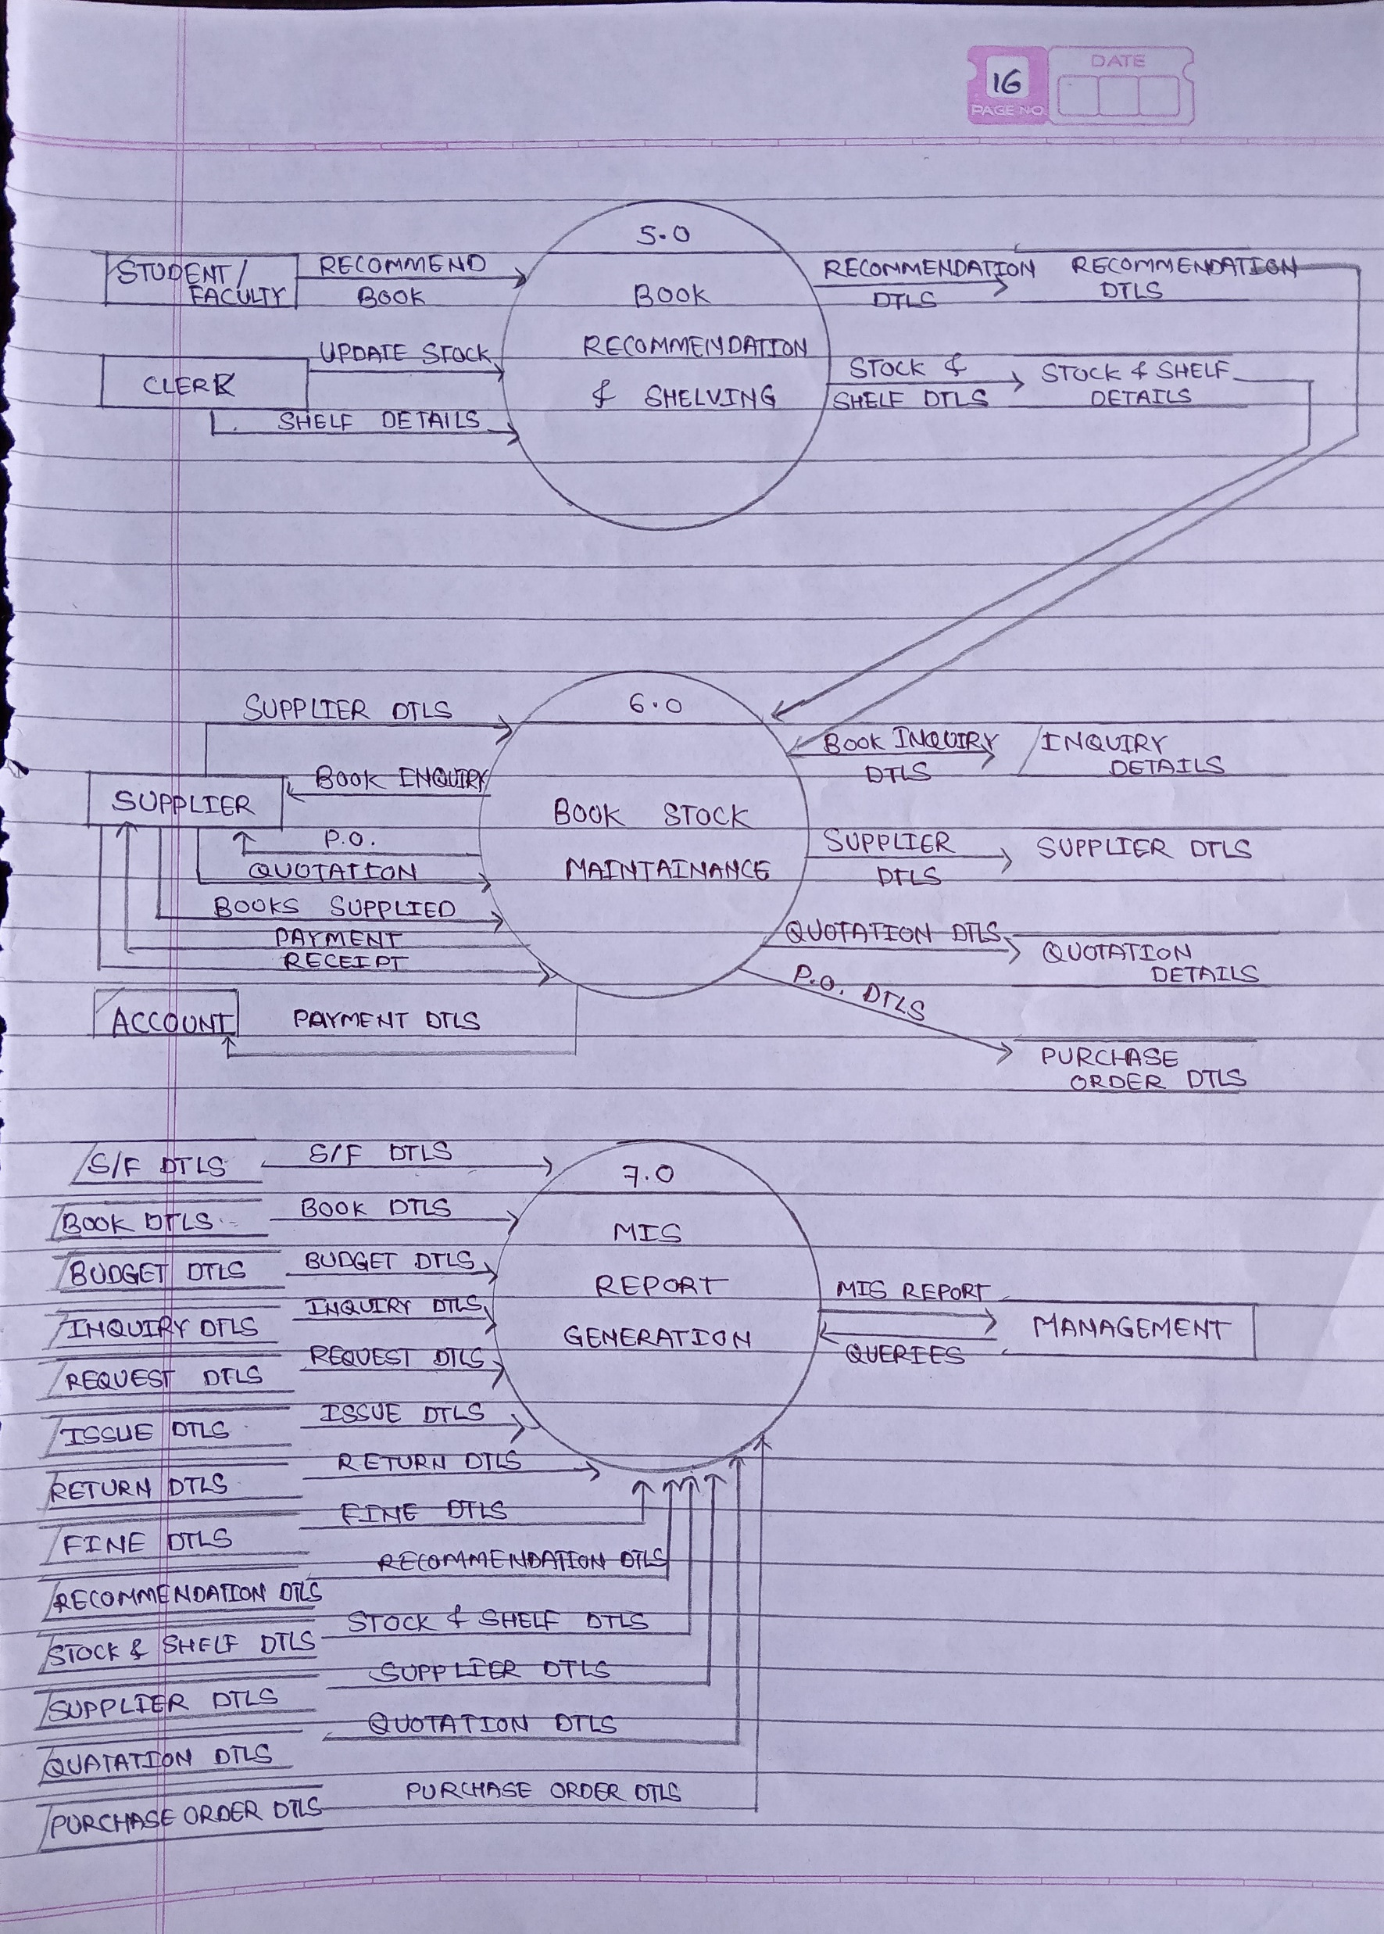
DATA FLOW DIAGRAM

Slide 17
Use Case Diagram

Slide 18


Use Case Diagram
A Use case diagram shows how actor or user interact with the system. Actors can be of 2 types: A : Primary B : Secondary. Also known as Human and Non-Human.
A use case diagram is a way to summarize details of a system and the users within that system.
A use case diagram is a graphic depiction of interactions among different elements in a system.
Notations for Use Case Diagram
- Actor 1 (Human)
- Association
- Process
- Actor 2( Non-Human)
- Boundary

Slide 19
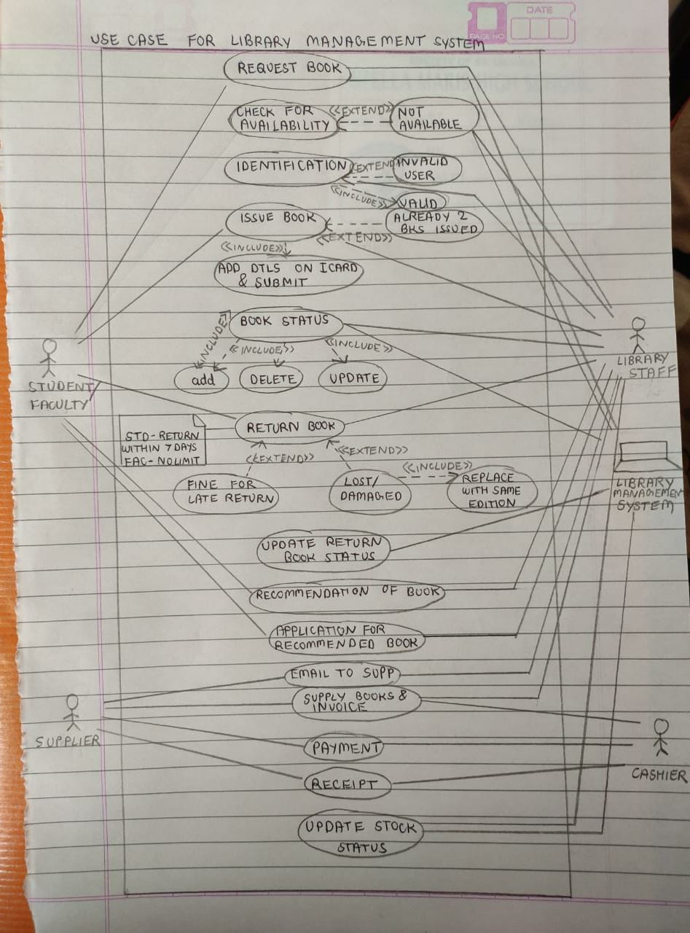
Use case--- Diagram

Slide 20
Class Diagram

Slide 21
Class Diagram
A Class diagram shows how the entire system works with reference to classes, objects, relationships and association shared amongst them.
A Class diagram contains multiple classes & show how objects are interacting with each other.
A class can be understood as superclass, class & subclass.
A subclass or an object is responsible to inherit the properties of a superclass.
Multiplicity
One (1) - Indicates that exactly one entity type instance exists at the association end.
zero or one (0..1): Indicates that zero or one entity type instances exist at the association end.
many (*): Indicates that zero, one, or more entity type instances exist at the association end.

Slide 22
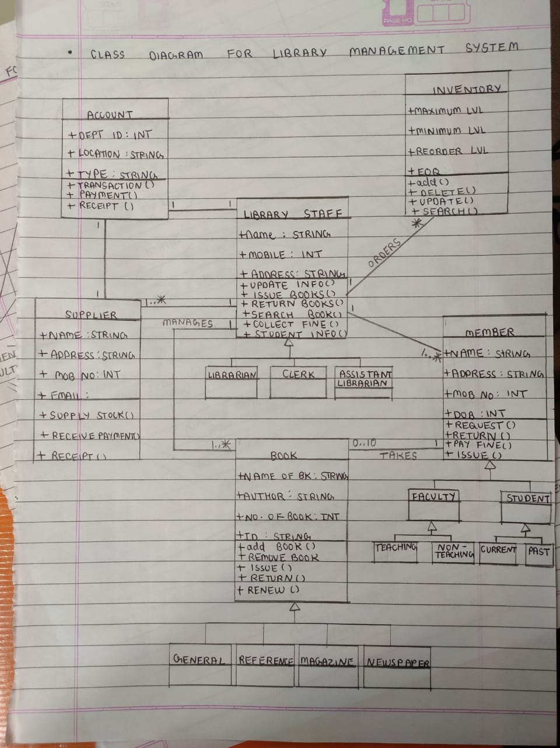
CLASS DIAGRAM

Slide 23
Activity Diagram

Slide 24
Activity Diagram
An activity diagram is responsible for modeling the dynamic aspects of system.
An activity diagram is essentially a flowchart shows the flow of control from activity to activity.
An activity diagram shows concurrency as well as branches of control.
Activity Diagrams are important in constructing executable systems through forward and reverse engineering.
Notations for Activity Diagram
- Activity/Actions
- Transition
- Notes
- Start
- Split
- Concurrent Fork (and)
[ Guard Condition ]
– Tells more about a program
- End
- Concurrent Join
- Decision Point

Slide 25
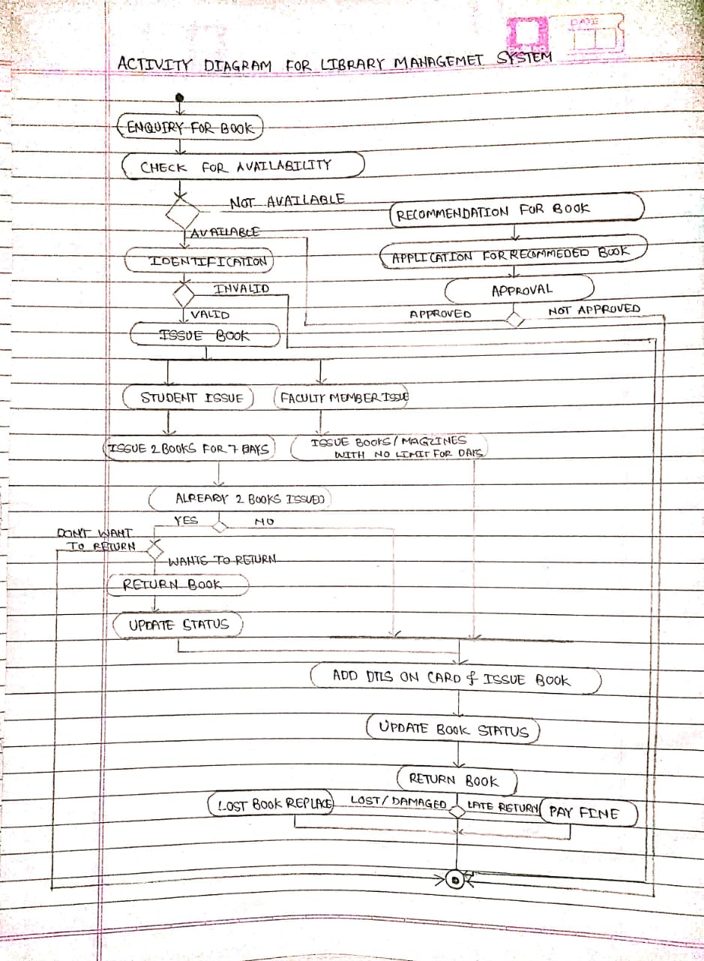
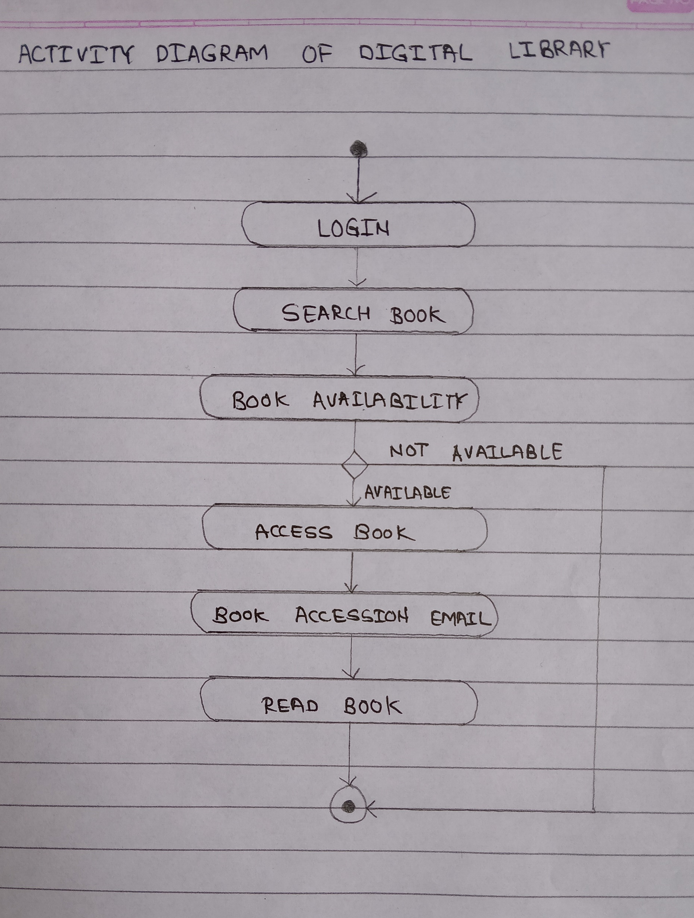

Slide 26
Sequence Diagram

Slide 27

Sequence Diagram
A sequence diagram shows the sequence of messages passed between objects.
A sequence diagram can also show the control structures between objects.
A sequence diagram consists of a group of objects that are represented by lifelines, and the messages that they exchange over time during the interaction.
A Sequence diagram show how objects and components interact with each other to complete a process.
- Lifeline
Notations for Sequence Diagram
- Activation Box
Name
- Active Objects/Roles
- Termination/End

Slide 28
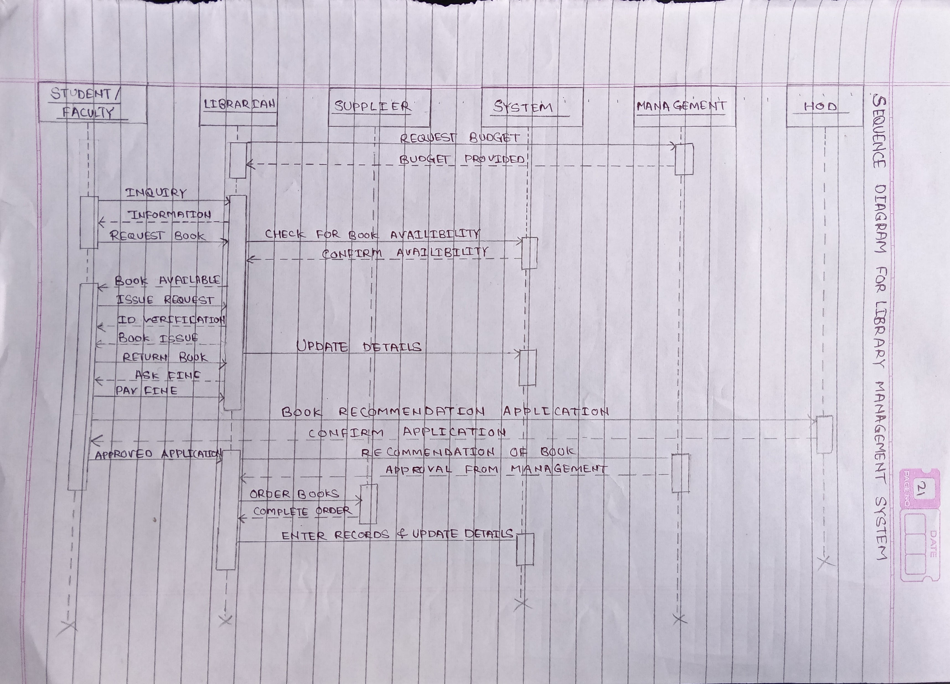
Sequence Diagram

Slide 29
Challenges
One Student can only issue 2 books at once
Magazines are not issued to students.
Reference books suggested by Professors are available in very less quantity, it is like First come first serve basis.
Too much manual work is involved in the system.

Slide 30

Thank You

